Slide 1


Artificial Intelligence and Data Science
Data Science and Visualization
24ADI204
DATA-VIZ HACK-A-BIT (2025-2026)
Team Number:4
1. ADHIRAJ S 24BAD003
2.JANASREE P 24BAD040
3.KRITHIKA K 24BAD061
4. MADHUSRI S 24BAD065

Slide 2
Project Walkthrough
01. Project Scope
07. Data Cleaning
13.Key Insights /Results
02.Problem Statement
08. Outlier Handling
14.Dashboard
03. Objectives
09. EDA
15.Demo Video
04. Project Workflow
10. Correlation Analysis
16.Future Enhancements
05. Dataset Overview
11. Feature Engineering
17.Team Contribution
06. Target Variable
12. PCA
18.Conclusion/Reference

Slide 3


Project Scope
Suggest Music directors on how people 's preferences over music change
Focuses on analyzing Spotify music trends dataset over recent years
Covers data cleaning, preprocessing, and exploratory data analysis (EDA)
Studies relationships between audio features, genre, and popularity
Identifies patterns and changes in listener preferences over time
Applies feature engineering techniques to improve data quality
Can be extended for machine learning models and recommendation systems in future

Slide 4
Problem Statement
The rise of digital music platforms like Spotify has made music consumption more dynamic and data driven. With thousands of songs released regularly, understanding what makes a song popular has become challenging. Listener preferences keep changing over time, influenced by trends and audio features like energy, danceability, and tempo. This project focuses on analyzing Spotify music trends to understand how these factors affect popularity and how music tastes have evolved over the years.

Slide 5
Objectives
To analyze Spotify music trends over the last decade
To understand how audio features (energy, danceability, tempo, etc.) affect popularity
To identify changes in listener preferences over time
To explore relationships between genre, features, and song success
To perform data cleaning, analysis, and visualization for meaningful insights
To prepare data for future machine learning and prediction tasks

Slide 6
Project Workflow
Loaded Dataset(Spotify_data.csv)
Used info(),describe() to know about the features like popularity ,danceability ,energy ,tempo etc..
Separated numerical columns and filled missing values using mean imputation
Detected outliers using Z-Score and used Box plot to visualize Outliers
Feature selection for PCA (Popularity,Energy,tloudness...)
Dimensionality reduction (7 features to 3 features)
Interactive Power BI Dashboard
Exploratory data Analysis
label encoder and powertransformer for encoding categorical features
Standard scaling for normalizing values
Bivariate analysis for popularity/year ,popularity/genre ,Danceability vs Popularity/genre
Univariate analysis for popularity ,energy ,tempo ,loudness

Slide 7
Dataset Overview
• The dataset contains Spotify songs with various audio features and popularity information. • Each row represents a song, and each column represents a specific feature. • It includes details like song characteristics, genre, and popularity metrics. • Covers multiple songs across different genres and years. • Audio features are numerical and useful for analysis and modeling. • Dataset may contain missing values and outliers, which require preprocessing. • Suitable for exploratory data analysis, visualization, and machine learning tasks. • Helps in understanding music trends and listener behavior patterns

Slide 8
Target Variable
Primary Target Variable = Popularity Genre = Supporting/analysis variable
Represents song success → Popularity directly shows how well a song is received by listeners
Main goal of analysis → The project aims to understand what makes a song popular
Dependent on other features → Audio features like energy, danceability, tempo, and genre influence popularity
Useful for prediction → Helps in building models to predict future hit songs
Supports industry decisions → Artists and platforms (like Spotify) can use it to improve music production and recommendations

Slide 9
Data Cleaning
• Missing values were handled using mean imputation, ensuring no data loss • Outliers were detected using boxplots and Z-score methods and treated accordingly • Duplicate records were removed to improve data quality • Data types were corrected for consistency and proper analysis • Data cleaning improved accuracy, reliability, and consistency of the dataset • Prepared a clean and structured dataset suitable for EDA and modeling

Slide 10
Outlier Handling
Outliers are extreme values that differ significantly from other data points
They can distort analysis and reduce model accuracy
Detection Methods Used:
Boxplots (to visually identify extreme values)
Z-score method (values beyond ±3 standard deviations)
Handling Approach:
Identified significant outliers carefully
Avoided unnecessary removal of data
Treated only impactful outliers
Benefits:
Improves data accuracy and reliability
Prevents misleading analysis results
Enhances visualization quality
Prepares dataset for better machine learning performance

Slide 11
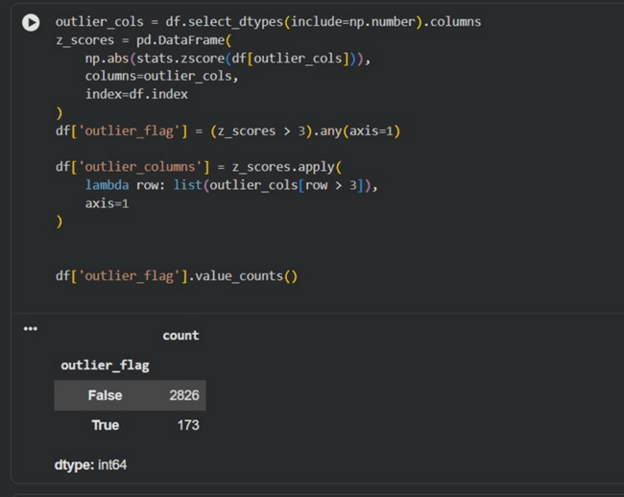
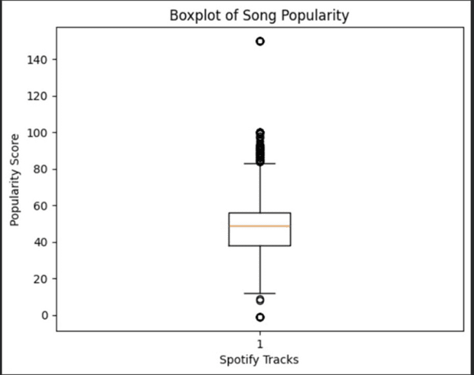
Outlier Handling

Slide 12
Exploratory Data Analysis
Understands data patterns and trends
Univariate Analysis:
Popularity is mostly in 40–60 range
Energy & danceability are moderate to high
Tempo varies widely
Genre imbalance exists
Bivariate Analysis:
Popularity changes over years
Some genres are more popular
Energy & danceability show slight positive impact
Key Insights:
Most songs are moderately popular
No single feature dominates popularity
Benefits:
Identifies patterns and relationships
Supports better analysis and modeling

Slide 13
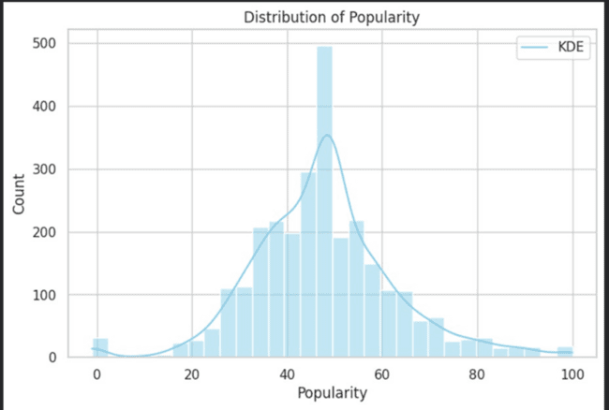
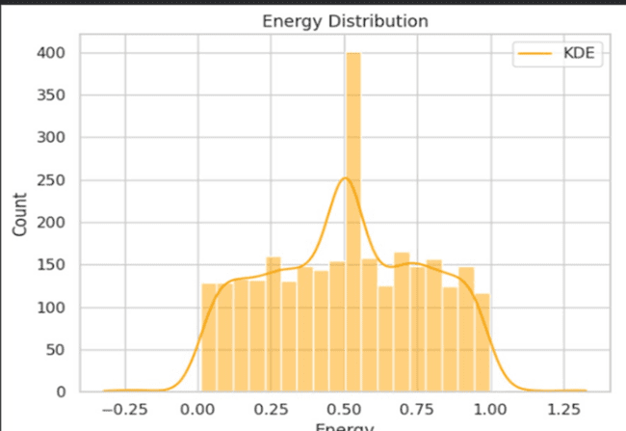
Exploratory Data Analysis

Slide 14
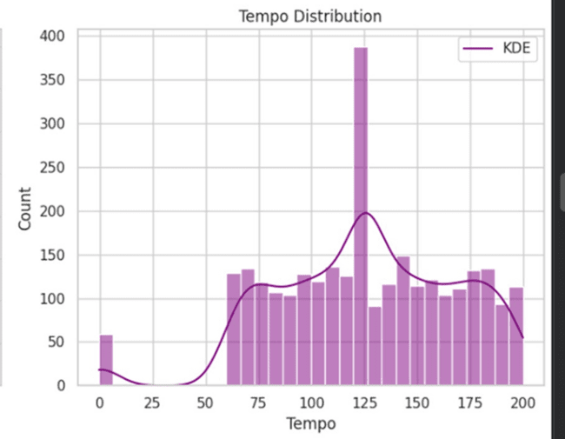
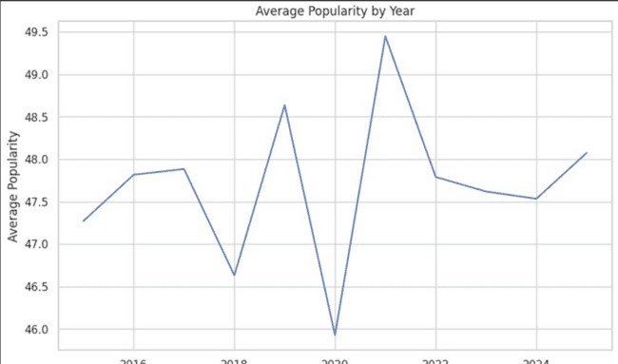
Exploratory Data Analysis

Slide 15
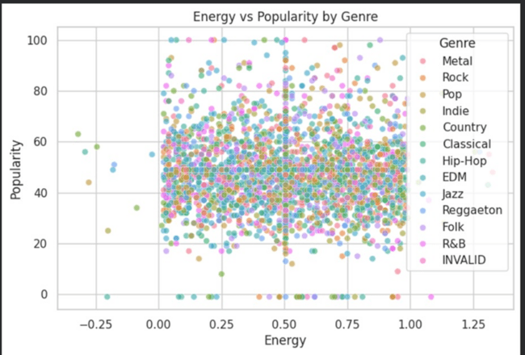
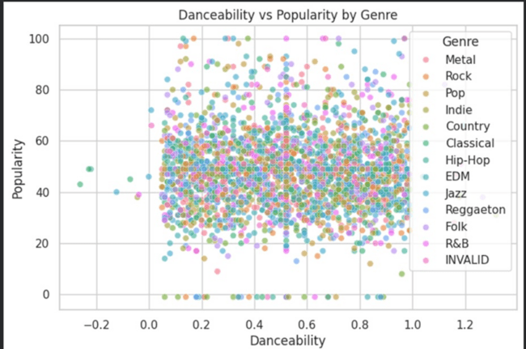
Exploratory Data Analysis

Slide 16
Correlation Analysis
Shows how strongly features are related to each other
Uses correlation matrix (heatmap) for easy visualization
Values range from -1 (negative) to +1 (positive relationship)
Most values are near 0 → very weak relationships between features
No strong correlation found between audio features and popularity
Features like energy, danceability, and tempo have only slight influence
Indicates popularity depends on multiple combined factors
Helps in selecting useful features and improving analysis

Slide 17
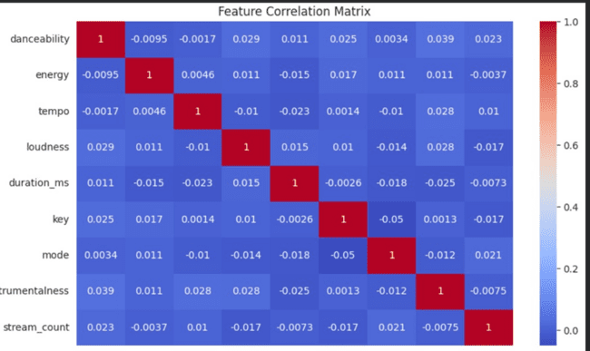
Correlation Analysis

Slide 18
Feature Engineering
Process of transforming data to improve model performance
Converts raw data into a more useful and meaningful format
Applied Standard Scaling to normalize numerical features
Used Label Encoding to convert categorical data into numeric form
Handled skewness using power transformation (Yeo-Johnson)
Reduced data imbalance and improved distribution of features
Helps models learn better patterns from the data
Improves accuracy and overall analysis quality

Slide 19
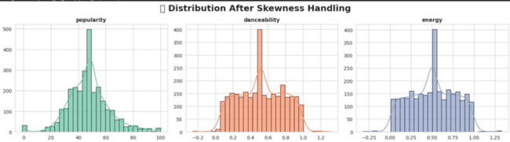
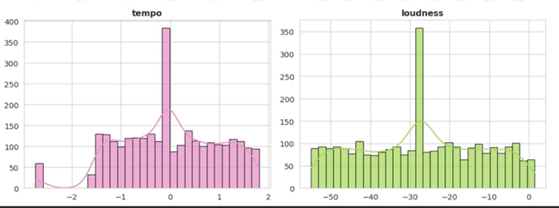
Feature Engineering

Slide 20
Dimensionality Reduction
Reduces number of features while preserving important information
Applied Principal Component Analysis (PCA) in the project
Used to transform original audio features into fewer components
Helps handle weak correlations between features (as seen in analysis)
Simplifies complex dataset for easier analysis and visualization
Reduces noise and redundancy in the data
Improves efficiency of further analysis and modeling
Supports better understanding of overall music trends

Slide 21
Key Insights / Results
Certain genres dominate the dataset, showing higher listener preference
Popular genres consistently have higher average popularity scores
Music directors should focus on high-performing genres to match audience taste
Moderately energetic and danceable songs are more preferred by listeners
Audience preference is not random — it follows clear genre trends
Trends change over time, so genre popularity should be monitored regularly
Combining popular genre + suitable audio features (energy, danceability) increases success chances
Overall, the project shows that music success is driven by multiple factors and evolving audience behavior

Slide 22
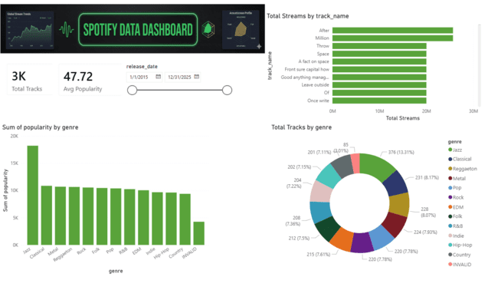
Visualization Dashboard

Slide 23
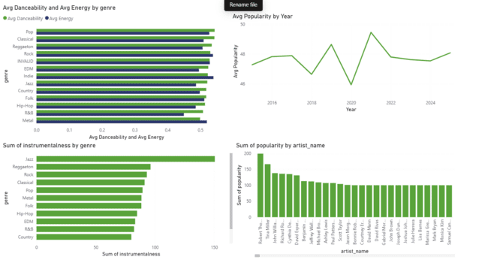
Visualization Dashboard

Slide 24
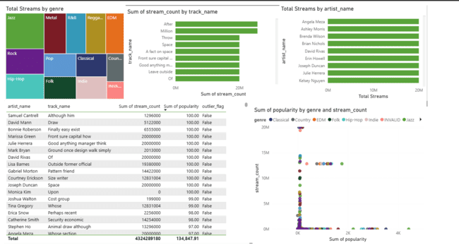
Visualization Dashboard

Slide 25
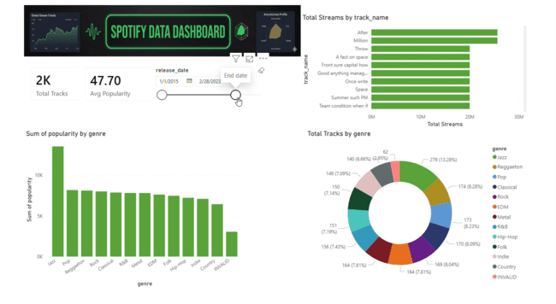
Demo Video

Slide 26
Future Enhancements
Apply machine learning models to predict song popularity
Build a music recommendation system for users
Use deep learning techniques for better pattern detection and accuracy
Integrate real-time streaming data for dynamic trend analysis
Expand dataset with lyrics, mood, and user behavior features
Develop interactive dashboards for better visualization
Incorporate user listening history for personalized recommendations
Perform region-wise and time-based analysis to capture changing preferences

Slide 27
Individual Contribution
Team Member | Work Assigned | Outcome
Adhiraj | Interactive Dashboard | Structured interactive Dashboard
Janasree | Code Recheck and Final report | Verified Code for all weeks and helped with report
Krithika | Code correction and validation | Structured week 6 code completely
Madhusri | Code Implementation | Verified the correctness of the code

Slide 28
Conclusion and References
This project focuses on analyzing Spotify music trends using a real-world dataset to understand how music preferences have evolved over time. It involves data preprocessing, handling missing values using mean imputation, outlier detection, and exploratory data analysis (EDA). The study examines relationships between audio features like energy, danceability, tempo, and popularity. Feature engineering techniques were also applied to improve data quality. The project successfully identifies patterns, trends, and key factors influencing music popularity.
REFERENCES:
Spotify Music Trends Dataset (Kaggle)
Dataset link:
https://drive.google.com/file/d/1Tg8PsIE0QLwRdZzDV8T1nD1aMzpvKsk/view?usp=drivesdk
Github link:
https://github.com/JANASREE-P/24ADI004_DSV_TEAM4.git

